Slide 1
2024 SWTest Asia – Tutorial
Submitting an abstract

Slide 2
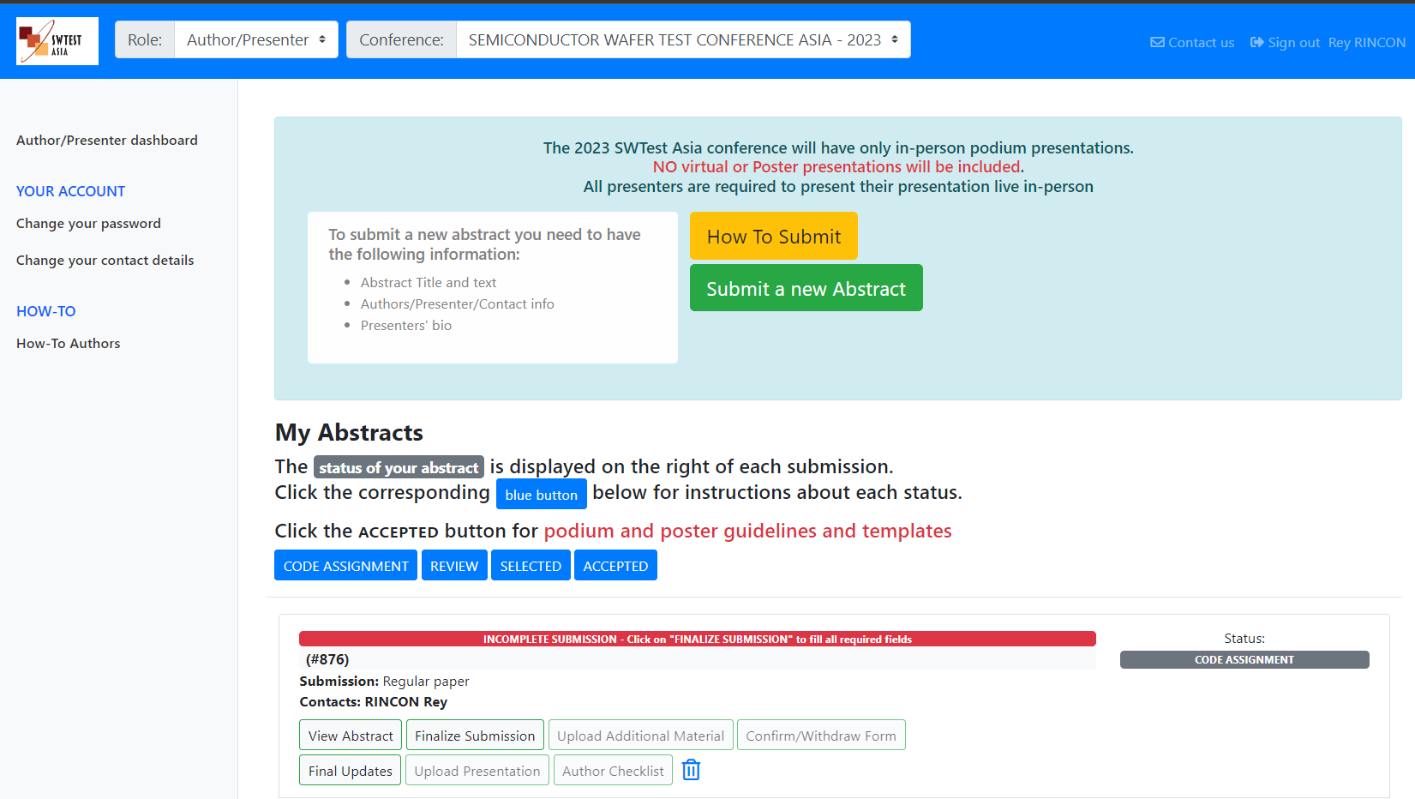
This is your main Author/Presenter’s Dashboard
To return to this page, click here
To change your password or contact details, click here
This area describes the various states that your submission will be in during our code assignment (incomplete submission), review, selection & final acceptance
Presentation guidelines/slide master for your paper, click here
To download this Tutorial, click here
To start the submission process, click here

Slide 3
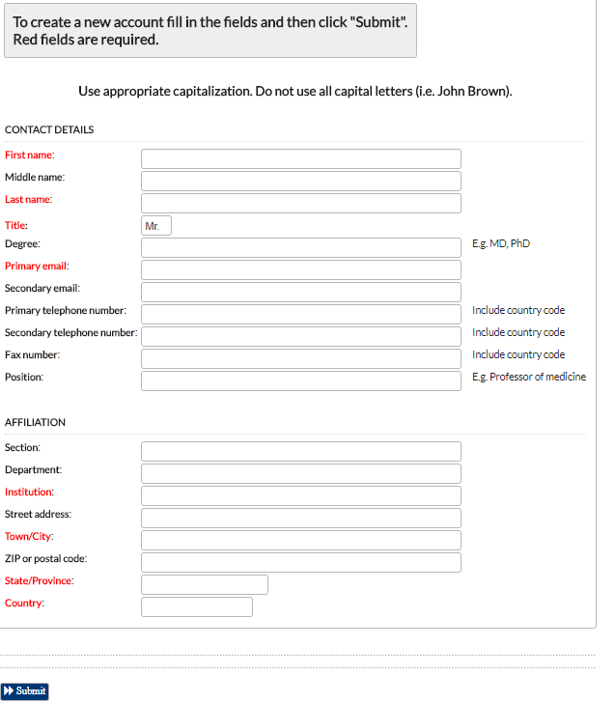
Before you start
Gather the following contact information before you start your submission for everyone involved with your submission:
For each Contact person and All Presenters & Authors
First & Last Name
Title
Primary email address
Institution/Company Name
Town/City
State/Province
Country
Presenters are required to submit a Bio
Also determine the order you want everyone to be listed in the proceedings & SWTest Asia website

Slide 4
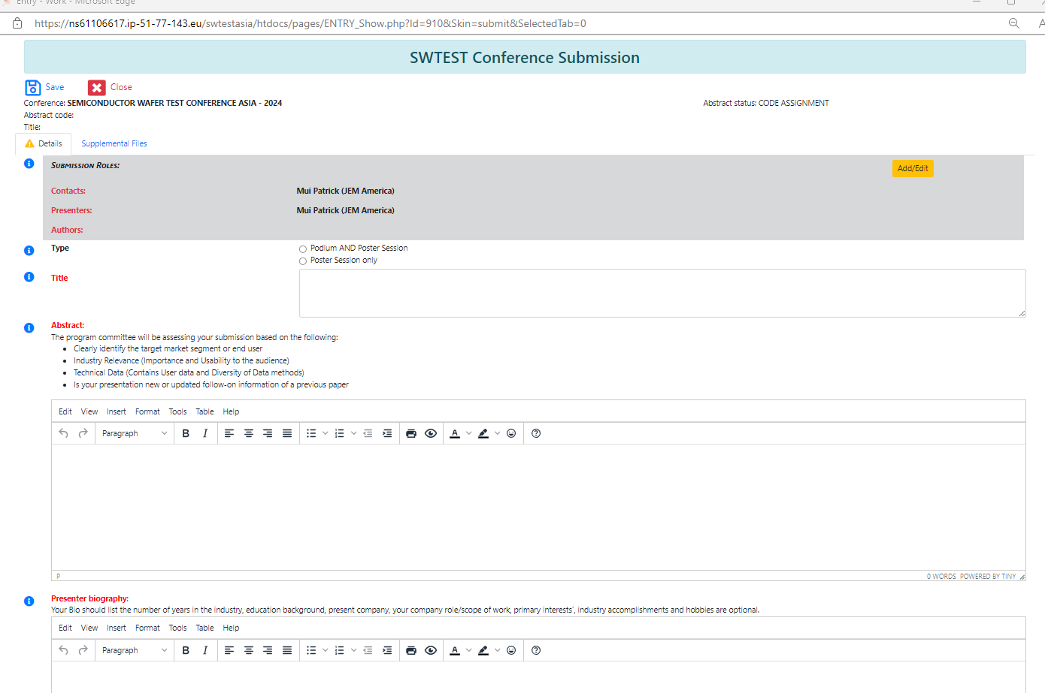
Fill out all the information requested in each category
Do not click on the
“Save” button until all fields are filled in
If you are do not fill in all of the fields, your submission will not be accepted for consideration and will be listed as “Incomplete Submission”
You will be able to fix it by going to the main Authors Dashboard and selecting the “Finalize Submission” button and filling in all the missing fields
Add Presenters & Authors here
Select the type of presentation
Add title here
Add Abstract here
Add Bio’s for each presenter here.

Slide 5
To “Add/Edit” names,
Select “Add User”
- Type in the person’s required information
- Assign role (Contact, Presenter or Author)
- Use the up and down arrows to select the order you want them listed on the program proceedings
- When done, select the “Update Info” button
Insert the headshot

Slide 6
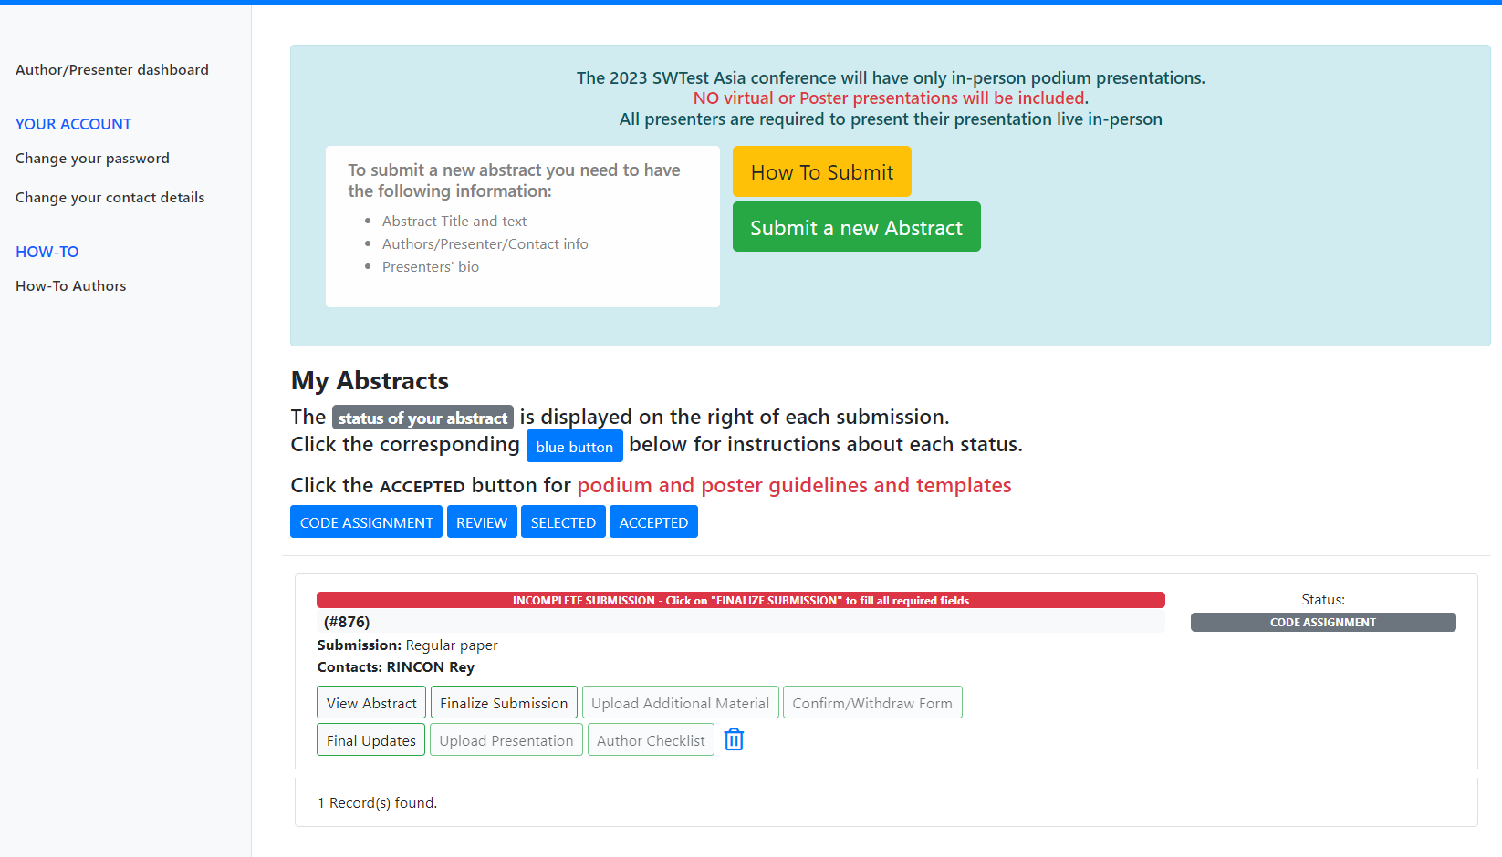
Your submission/s will be listed here
To view your abstract, click here
To Update your Submission,
click here
Your submission/s “Status” will be shown here

Slide 7
If you have any questions or need help, please contact one of the SWTest Asia Conference Chairs, listed below
Jerry Broz, Ph.D. General Chair SWTest Asia (303) 885-1744
E: jerry.broz@swtest.org
Clark Liu Asia Technical Program Chair SWTest Asia
+886-975-658-563 E: clark.liu@swtest.org
Nobuhiro Kawamata Japan Program Chair SWTest Asia +91-80-2644-7319
E: nob.kawamata@swtest.org
Maddie Harwood Finance Chair & Conference Mgmt.
CEM, Inc. (540) 937-5066 E: maddie.harwood@swtest.org
Rey Rincon Technical Program Co-Chair SWTest Asia (214) 402-6248
E: rey.rincon@swtest.org

